Slide 1
Modular Arithmetic
7th Grade Lesson Plan
by Brooke Cope and Jennifer Call

Slide 2
What time will the clock show?
It is now 5 o’clock; what time will it be in 2 hours?
What time will it be 5 hours after 9 o’clock?
What is 26 hours after 8 o’clock?
It is 3 o’clock now; what time will it be in 100 hours?
How can you model each situation?
7 o’clock
2 o’clock
10 o’clock
7 o’clock
Ideas come from Student Explorations in Mathematics, May 2012, 1-8
Notes:
Why do some of the answers follow regular addition rules, and others do not? (for example, 5 + 2 = 7 but 26 + 8 does not equal 10)

Slide 3
Modeling Time

Slide 4
Josh’s favorite song, ‘Livin’ on a prayer’ plays on a radio station at 9 o’clock every day. How many hours until Josh hears his song again, if it is…
Is there more than one possible answer?
5 o’clock?
10 o’clock?
9 o’clock?
4 hours, 16 hours, 28 hours, 40 hours, 52 hours, ….
11 hours, 23 hours, 35 hours, 47 hours, 59 hours, ….
12 hours, 24 hours, 36 hours, 48 hours, 60 hours, ….

Slide 5
What day will it be?
Today is Monday; what day will it be in 13 days?
Today is Thursday; what day will it be 23 days before?
Today is Sunday; what day will it be in 49 days?
Every Tuesday is ‘Taco Tuesday’ at Alyssa’s favorite restaurant. If it is Saturday, how many days until can enjoy ‘Taco Tuesday’ again?
Sunday
Tuesday
Sunday
3 days, 10 days, 17 days, 24 days, 33 days, …

Slide 6
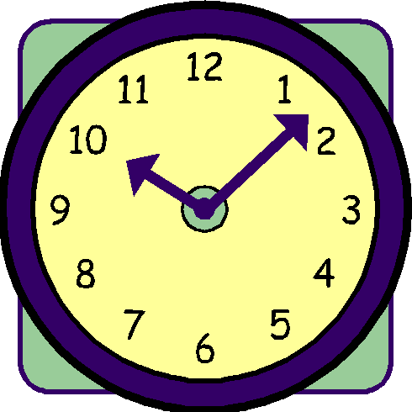
Introduction to Modular Arithmetic
Time is Divided to Two Twelve Hour Periods – this sets up a situation for mod 12 arithmetic, instead of 1 through 12, we will use 0 through 11.
It is now 5 o’clock; what time will it be in 2 hours?
What time will it be 5 hours after 9 o’clock?
What is 26 hours after 8 o’clock?
It is 3 o’clock now; what time will it be in 100 hours?
5 (mod12) + 2 (mod12) = 7 (mod12)
5 (mod12) + 9 (mod12) = 2 (mod12)
26 is 2 in (mod 12); 2 (mod12) + 8 (mod12) = 10 (mod12)
100 is 4 in (mod 12); 4 (mod12) + 3 (mod12) = 7 (mod12)

Slide 7
Modular Congruence
Josh’s favorite song, ‘Livin’ on a prayer’ plays on a radio station at 9 o’clock every day. How many hours until Josh hears his song again, if it is…
5 o’clock?
10 o’clock?
9 o’clock?
4 hours, 16 hours, 28 hours, 40 hours, 52 hours, ….
11 hours, 23 hours, 35 hours, 47 hours, 59 hours, ….
12 hours, 24 hours, 36 hours, 48 hours, 60 hours, ….

Slide 8
In order to calculate a check digit, we will need to understand the basics of a college topic--modular arithmetic. (Don't worry. If you can find the remainder of a division problem, you can do basic modular arithmetic.)
Whenever you divide a number, you can write the division problem in the following format:
A / B = Q with remainder R
Identify the quotient, dividend, and divisor in the equation above.
Write the following division problems in the format above.
1. 12 ÷ 5 2. 17 ÷ 4 3. 34 ÷ 7

Slide 9
In modular arithmetic, we're mostly interested in the remainder. So A / B = Q with remainder R becomes A mod B = R.
Write the following division problems in the modular arithmetic format. Then find the solution.
4. 12 ÷ 5 5. 17 ÷ 4 6. 34 ÷ 7
7. 42 ÷ 6 8. 27 ÷ 8 9. 97 ÷ 10
Find the solution to each equation written in modular arithmetic format.
10. 23 mod 4 11. 37 mod 5 12. 46 mod 6
13. 51 mod 7 14. 69 mod 8 15. 75 mod 9

Slide 10
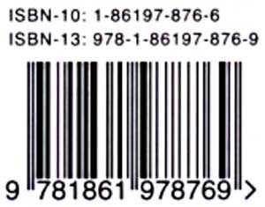
With so many identification numbers and codes used in commerce and other places, it's important to be able to "check" that the number is written, typed, or entered correctly.
A check digit is added somewhere in the identifying number to reduce errors made by humans or machines.
9781861978769bookland by BillPE
Some of the errors that check digits detect are the following:
single digit errors replacing 1 with 2
transposition errors switching 12 with 21
phonetic errors using "50" instead of "15"

Slide 11
In 1970, books began to be published with a 10-digit ISBN (International Standard Book Numbers). The first nine numbers helped to identify the country group, publisher, and title of the book. The last digit was a check digit for verification.
The first 9-digits of the ISBN for The Hobbit are 0-618-00221. Follow the steps below to determine the check digit.
1. Write the formula below replacing the letters with the digits from the ISBN.
(a x 10) + (b x 9) + (c x 8) + (d x 7) + (e x 6) + (f x 5) + (g x 4) + (h x 3) + (i x 2)
= (0 x 10) + (6 x 9) + (1 x 8) + (8 x 7) + (0 x 6) + (0 x 5) + (2 x 4) + (2 x 3) + (1 x 2)
2. Evaluate the expression.
= 0 + 54 + 8 + 56 + 0 + 0 + 8 + 6 + 2 = 134
3. Divide the sum by 11. Find the remainder.
134 mod 11 = 2
4. The check digit is the difference of 11 and the remainder.
11 - 2 = 9

Slide 12
The first nine-digits of the ISBN for Harry Potter and the Sorcerer's Stone are 0-590-35340. Find the check digit.
The check digit is 3.
Not including the check digit, how many unique ISBNs are there?
x
x
x
x
x
x
x
x
1,000,000,000
unique ISBNs
Why is this a problem?

Slide 13
Since January 1, 2007, books are now assigned a 13-digit ISBN number. A three digit EAN (European Article Number) was added to the beginning of the order. However, this changes the process of how the check number is created.
The first 12-digits of the ISBN for The Hunger Games are 978-0-439-02348. Follow the steps below to determine the check digit.
1. Write the formula below replacing the letters with the digits from the ISBN.
(a x 1) + (b x 3) + (c x 1) + (d x 3) + (e x 1) + (f x 3) + (g x 1) + (h x 3) + (i x 1) + (j x 3) + (k x 1) + (l x 3)
= (9 x 1) + (7 x 3) + (8 x 1) + (0 x 3) + (4 x 1) + (3 x 3) + (9 x 1) + (0 x 3) + (2 x 1) + (3 x 3) + (4 x 1) + (8 x 3)
2. Evaluate the expression.
= 9 + 21 + 8 + 0 + 4 + 9 + 9 + 0 + 2 + 9 + 4 +24 = 99
3. Divide the sum by 10. Find the remainder.
99 mod 10 = 9
4. The check digit is the difference of 10 and the remainder.
10 - 9 = 1

Slide 14
The first twelve-digits of the ISBN for Twilight are 978-031616017. Find the check digit.
The check digit is 9.
Not including the check digit, how many unique ISBNs are there with the 13-digit code?
=
10,000,000,000,000
unique ISBNs

Slide 15
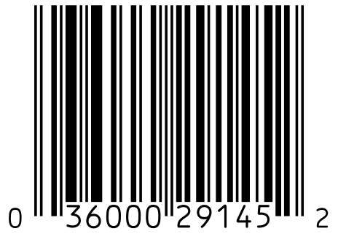
Ideas for improving the checkout process were started in the ​1930s. During the 1970s, several different shapes and styles ​of bar codes were suggested. By the 1980s, most items in ​stores were labeled with the traditional UPC (Universal Product ​Code).
Traditional UPC codes are 12 digits long. ​The first digit indicates the type of ​product. The next five digits are the ​manufacturer's identification number. The ​following five digits are used to indicate a ​particular product. The final digit is a ​check digit.

Slide 16
The first 11-digits of the UPC for a box of graham crackers are ​0-11110-09108. Follow the steps below to determine the check ​digit.
1. Find the sum of all of the odd place-value digits. Multiply the sum by 3.
= 0 + 1 + 1 + 0 + 1 + 8 = 11
11 x 3 = 33
2. Find the sum of all of the even place-value digits. Add this sum to the above ​product.
= 1 + 1 + 0 + 9 + 0 = 11
11 + 33 = 44
3. Divide the sum by 10. Find the remainder.
44 mod 10 = 4
4. The check digit is the difference of 10 and the remainder.
10 - 4 = 6

Slide 17
The first 11 digits of the UPC for a box of cereal are ​0-16000-40608. Find the check digit.
The check ​digit is 7.
Not including the check digit, how many unique UPCs are there?
100,000,000,000
unique UPCs

Slide 18
Additional Activity Time ?

Slide 19
Additional Activities for the Classroom
7th grade honors core: systems with different bases:
http://labyrinth.thinkport.org/www/educators/resources/lessons/shipping_grade7.pdf
http://www.mathmaniacs.org/lessons/01-binary/
http://k12math.com/math-concepts/numbers/bases.htm
http://math.about.com/od/calculuslessons/a/changebase.htm
http://www.shodor.org/interactivate/activities/NumberBaseClocks/
http://www.discoveryeducation.com/teachers/free-lesson-plans/concepts-in-numbertheory.cfm
http://math.sfsu.edu/cm2/papers/mikeh.p2.pdf

Slide 20
7th Grade Utah Honors Core
Cluster Title: Codes
Standard: Examine the use of mathematics in creating codes.
Concepts and Skills to Master
• Explore codes used in commerce such as check digits, UPC codes, and bank numbers.
Guiding Instructional Questions
• How does the use of codes facilitate commerce and other aspects of everyday life?
• Why do stores scan your receipt when you return an item?
Instructional Strategies
• Collect a variety of UPCs and compare the codes to investigate product information.

